Slide 1
Managing Transfer-Based Datacenter Connections
Daniel Naro - Victoria Beleuta - María Gabriela Valdés

Slide 2
Problem Statement
Decide whether a transfer-mode request is accepted or not, the controller solves the routing and scheduled spectrum allocation (RSSA) problem.
The RSSA problem decides the elastic operations to be done so as to make enough room for the incoming request, and still respect the constraints.
2/
Notes:
Constraints: data ammount and time completion of every transference

Slide 3
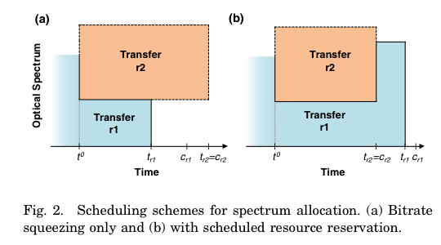
Scenarios
Fig. 2(a) can be squeezed, thus increasing its scheduled completion time tr1, but without violating the committed completion time, cr1. Released resources can be used to set up an optical connection to support the requested transfer r2.
3/

Slide 4
Scenarios
Fig. 2(b), where to ensure the committed completion time for transfer r1, some resources need to be returned to that transfer as soon as transfer r2 is completed.
4/
Notes:
In view of the example, it is obvious that spectral resources need to be scheduled so as to be allocated to some transfer in the future. It is clear now that elastic operations include increasing and decreasing connections’ bitrates.

Slide 5
Implementations:
ILP
Greedy Algorithm + Local Search
GRASP + Local Search
5/

Slide 6
ILP Problem Statement
Given:
network topology G(L,E);
datacenters D⊆L;
a set S of available spectrum slices for each link;
capacity and number of flows in each location;
a set R of current transferences in progress;
for r ∈ R, the tuple (or; dr; vr; cr; rr; s0r; s1r; t1r; tr);
the new transfer-mode request with (or ; dr ; vr ; cr) and t0 denoting the current time;
6/

Slide 7
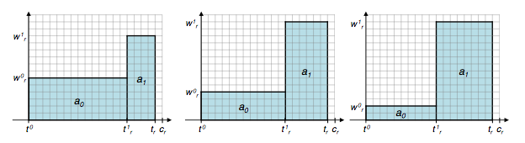
ILP Model
Precomputation: sets of feasible rectangles for each ongoing transference;
set A0 contains rectangles specifying allocation w0r from time t0 to t1r;
set A1 specify scheduled allocation w1r from t1r to tr;
matrix β01 indicates whether rectangle pair a0 ∈ A0 and a1 ∈ A1 is a feasible scheduling;
9/

Slide 8
Problem Statement
Output:
the route (rr);
the slot allocation (s0r);
the scheduled completion time (tr) for the new transference request;
the bitrate of the connection b(s0r; l(rr));
the new spectrum allocation (w0r);
scheduled reallocation (w1r;t1r);
completion time (tr);
7/

Slide 9
Problem Statement
Objective:
minimize the number of connections to be rescheduled to make room for the incoming request.
8/

Slide 10
Greedy Algorithm
get minimum admissible bitrate for requested transference;
get shortest-path for route required;
in case a feasible solution is found, the slot with maximum width is assigned to the required transfer;
otherwise, adjacent transfers are asked to free necessary slots;
10/

Slide 11
GRASP Algorithm
C = path(source, destination);
qc = sizeof(path);
α = 0.3;
RCL = qmin + α (qmax - qmin);
11/

Slide 12
Main Algorithm Structure
Trivial Case:
12/

Slide 13
Main Algorithm Structure
Half Hard Case:
13/

Slide 14
Main Algorithm Structure
Hard Case:
14/

Slide 15


Example 1
inputTestHardAndTrivial
RT: a - e
NOTE: All CPLEX time correspond to “CPLEX MIP Optimization” in the Profiler
15/

Slide 16
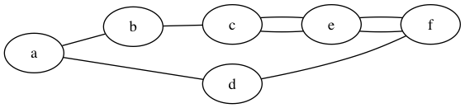

Example 2
inputSeeDifferencesGreedyCplex
RT: a - e
16/

Slide 17


Example 3
inputTestHalfHard
RT: a - e
17/

Slide 18
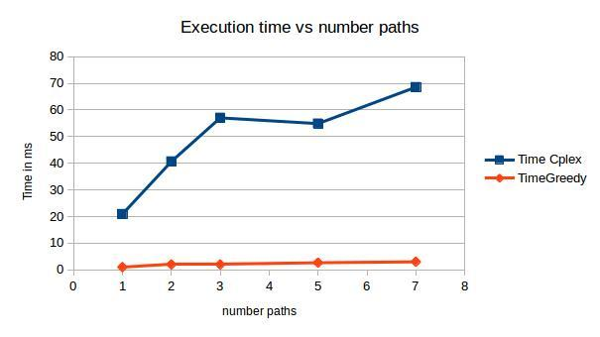
Example multiple hard paths
18/

Slide 19
Local search
Input: all the free slices obtained after reschedules
We iterate over them and check if there is a subset big enough
Can we undo reschedules with the space we do not use?
19/

Slide 20
Heuristic Versus ILP Model
Greedy approach is the fastest and with the local search approximate quite well the optimum.
GRASP can find better solutions, but takes longer
ILP always find the best solution and is the slowest if we include every step of the execution
12/

Slide 21
Thank you!

